Slide 1
Real Time Operating System “FreeRTOS” Part 2

Slide 2
Agenda
Accurate task periods
Continuous & Periodic Tasks
Changing Tasks priorities
Deleting tasks

Slide 3
Accurate Tasks Periods
vTaskDelayUntil() is similar to vTaskDelay() “but”
vTaskDelay() parameter specifies the number of tick interrupts that should occur between a task calling vTaskDelay() and the same task once again transitioning out of the Blocked state.
The length of time the task remains in the blocked state is specified by the vTaskDelay() parameter, but the actual time at which the task leaves the blocked state is relative to the time at which vTaskDelay() was called.
The parameters to vTaskDelayUntil() specify, instead, the exact tick count value at which the calling task should be moved from the Blocked state into the Ready state.
vTaskDelayUntil() is the API function that should be used when a fixed execution period is required (where you want your task to execute periodically with a fixed frequency), as the time at which the calling task is unblocked is absolute, rather than relative to when the function was called (as is the case with vTaskDelay()).
vTaskDelayUntil() API function is available only when INCLUDE_vTaskDelayUntil is set to 1 in FreeRTOSConfig.h.

Slide 4
Accurate Tasks Periods

Slide 5
Example 6: Continuous & Periodic Tasks

Slide 6
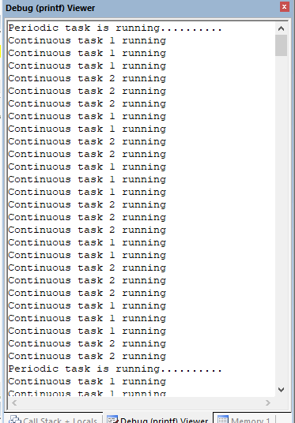
Example 6: Continuous & Periodic Tasks

Slide 7
Priorities & Preemption
1_three_tasks_same_priority
2_three_tasks_different_priority
3_three_tasks_preemption_delete_task (Example 9)

Slide 8
Deleting a Task; Example 9

Slide 9
Deleting a Task; Example 9
Task 2 Preempts 1
Task 1 Resumes

